Slide 1
Lead the AI era with the Microsoft Cloud
Bryan Chua
CTO, Strategic Enterprise Accounts
Notes:
I’m excited to talk to you today about how we can help you lead your organization and your customers into the era of AI – today – with the Microsoft Cloud.

Slide 2
The world is changing
Industries are transforming rapidly
The drivers for economic growth are evolving
The world is more connected than ever
Notes:
Let’s start with the world today. Things all around us are changing rapidly, and organizations need to adapt. This is nothing new.
If you look back just a few years, we saw that organizations that had already invested in their own digital foundation were able to weather the disruption of the pandemic better than their peers, with many of them emerging even stronger than before.
We believe we're on the cusp of a similar inflection point today.
The pressures today are different – the global workforce is shrinking, productivity is stagnant, and security threats emerge and evolve faster than ever.
But the pace of change hasn’t slowed.

Slide 3
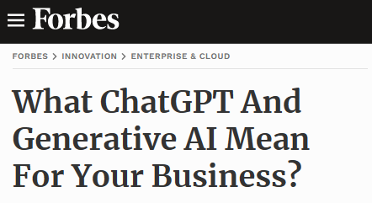
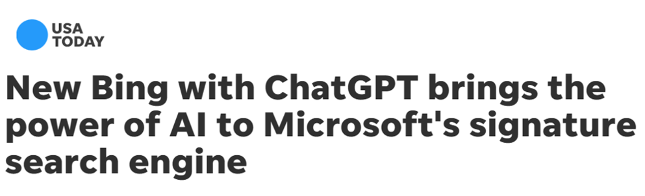
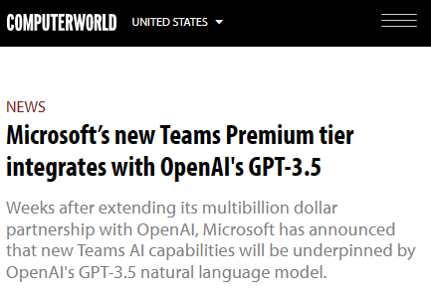
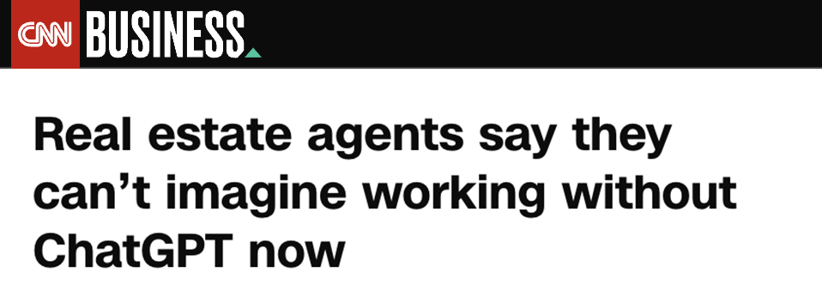
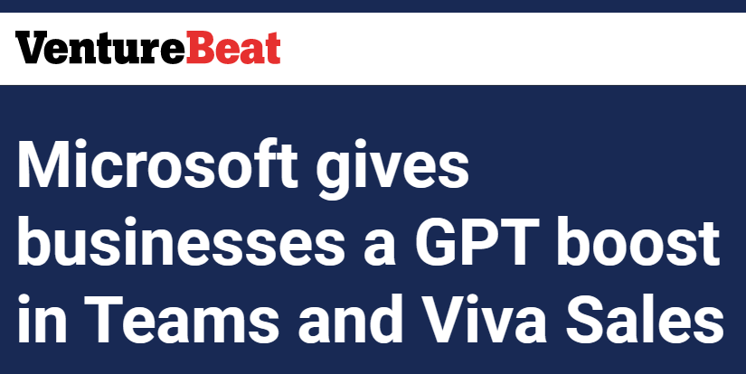
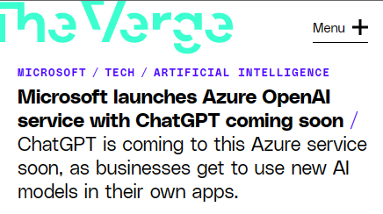
The AI technology is here
Notes:
Technology is advancing quickly, grabbing headlines every day.
Experiences based on large language models, like ChatGPT, have taken the world by storm, in part because they can draw a vast store of data leveraging the massive computing power available today in the cloud.
We’ve seen this technology break through with consumers – it’s not just for tech anymore.
As a result, you can expect your employees to start demanding these kinds of experiences in the tools they use each day. Similarly, your customers will quickly come to expect AI capabilities in the services you offer, if they don’t already.
But there’s an exciting third element – and that’s the real, tangible impact technology like this can drive.

Slide 4
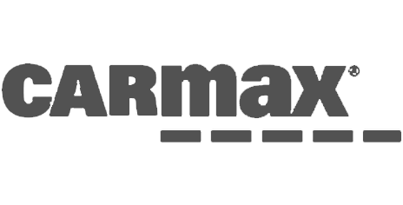


And the impact is real
Carmax estimates an individual would take 11 years to do what Azure OpenAI Service was able to do in days
Progressive is saving $10M annually with AI-powered chatbots
EY is saving 250K hours of manual work per client using intelligent document automation
Notes:
It’s real – and organizations across industries are seeing the benefits of AI today.
Carmax, for example, deployed Azure OpenAI Service on top of its vast customer review database – and can quickly generate unique summaries for the cars available on their website.
Progressive is using AI-powered chatbots to save $10 million every year as their bots answer up to 200,000 queries each month with personalized, intelligent, text-based responses.
And EY is using intelligent document automation with its clients in its new contract auditing service, saving clients an average of 250,000 hours of manual work.

Slide 5
lead the AI transformation
The opportunity is yours to
Notes:
With the world changing, technology advancing, and the potential for real, meaningful impact, the opportunity is yours to lead the AI transformation.
How will your organization seize the full potential of AI, while safeguarding your business, your data, and your employees?

Slide 6

Empower every person and every organization on the planet to achieve more
Notes:
That’s where Microsoft can help.
Our mission at Microsoft is to empower every person and every organization on the planet to achieve more.
And as we enter the age of AI, that mission matters more than ever.
We are called upon to empower the world’s organizations to lead the AI transformation for a new era – and we have the track record to help you do it.

Slide 7
Microsoft is fueling AI innovation
Decades of research & development
Committed to advancing Responsible AI
Secure from the start
Reliability & performance at scale for large AI models
Trusted by AI leaders like OpenAI
Notes:
We have invested in fueling AI innovation for years.
We’ve spent decades in research and development.
We’re committed to advancing the principles and practice of Responsible AI.
We’ve built security and trust into our platform and all our solutions right from the start.
We’ve created purpose-built AI infrastructure to deliver reliability and performance at scale, based on thousands of interconnected GPUs and Infiniband networking.
As a result, we are trusted by AI leaders like OpenAI and many others. In fact, OpenAI builds and trains all of their AI models and experiences using the unique AI infrastructure of Microsoft Azure.
This innovation is exciting, and I am thrilled to share more with you over the course of this talk.
But as AI is poised to transform our lives, we must collectively define new rules, norms, and practices for the use and impact of this technology.

Slide 8
Microsoft’s Responsible AI principles
Privacy & Security
Building blocks to enact principles
Reliability & Safety
Inclusiveness
Tools and processes
Microsoft’s Responsible AI Principles
Training and practices
Rules
Fairness
Accountability
Governance
Transparency
Notes:
That’s why we began our Responsible AI journey back in 2017.
We believe that the development and deployment of AI must be guided by the creation of an ethical framework. In 2018, we set out our view that there are six core principles that should guide the work around AI.
But it’s not enough to define these principles – we need to operationalize them at scale as well.
We’re focused on four key areas to help put these principles into action:
First, you need governance.
Second, you need the rules to standardize AI requirements.
Third, you need training and best practices.
And fourth, you need the tools for implementation.
We’ll talk more about some of this tooling later on, but for now let’s ask the question:
How can you get started?

Slide 9




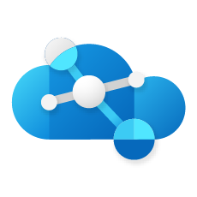
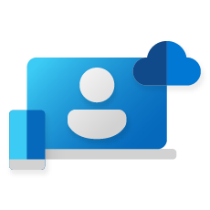
Microsoft Cloud
Industry clouds
c
b
a
Infrastructure
Comprehensive
Trusted
Security
Digital and app innovation
Microsoft Cloud
Radically accelerate your organization’s productivity with built-in AI
Business applications
Data and AI
Differentiate from the competition with intelligent apps using AI
Modern work
Notes:
That’s where we come back to Microsoft’s mission, and what we’ve built with the Microsoft Cloud.
The Microsoft cloud is unique in both the breadth and the depth of the cloud solutions we provide.
You can use each of our cloud solutions on a standalone basis or take advantage of the seamless way we’ve integrated and architected them to work well together.
And with the Microsoft Cloud, we can enable you to use AI to drive transformation within your organizations.
We are doing this in two ways:
First, we’ll help you radically accelerate employee productivity and capability by leveraging transformational AI built into every Microsoft Cloud solution.
And second, we are delivering the tools and services you need to build your own intelligent apps and services using Azure AI.

Slide 10
Microsoft Cloud
Your data is your data
Your data from any fine-tuning is not used to train the foundation AI models
Microsoft Cloud
Runs on trust
Runs on trust
Your data is protected by the most comprehensive enterprise compliance and security controls
Notes:
The Microsoft Cloud runs on trust.
Trust has been a fundamental promise we have built into the Microsoft Cloud since the very beginning.
Data is the fuel that powers AI technology – and you need to trust what your technology partners are doing with your data.
There are three fundamental promises we make with the Microsoft Cloud:
First, your data is your data. It is not our data. It is your data. That means it is yours to own and control. Your data to choose how you want to leverage and monetize.
Second, your data is not used to train or enrich the foundation AI models used by others. You don’t have to worry about anyone other than your organization is benefiting from AI that is trained on your data. Only your organization benefits from your data and business processes.
And third, your data and AI models – in fact, your entire organization – are protected at every step by the most comprehensive enterprise compliance and security controls in the industry.
That is Microsoft’s commitment to you. And that commitment should give you the confidence to leverage the power of AI to transform your businesses.

Slide 11
Microsoft Cloud
Industry clouds
c
b
a
Microsoft Cloud
Infrastructure
Comprehensive
Trusted
Security
Digital and app innovation
Radically accelerate your organization’s productivity with built-in AI
Business applications
Data and AI
Differentiate from the competition with intelligent apps using AI
Modern work
Notes:
Let’s go deeper now and talk about some of the work we are doing to radically accelerate productivity using AI built into the Microsoft cloud services.

Slide 12
Microsoft Cloud
Industry clouds
c
b
a
Infrastructure
Comprehensive
Trusted
Digital and app innovation
Security
Digital and app innovation
Business applications
Data and AI
Modern work
Notes:
Let’s start with how we’re bringing AI capabilities to life to power digital & application innovation.

Slide 13
One integrated developer platform
GitHub Enterprise
Redefine collaboration
Automate entire workflows
Secure DevSecOps
Loved by 100M+ developers
Used by >90% of Fortune 100
Notes:
We are living in a world where every organization is becoming a technology company, looking to be able to develop apps and solutions to power their business.
GitHub Enterprise provides developers with an integrated developer platform that they can use to collaborate, automate and secure their DevOps solutions.
GitHub is used and loved by more than 100 million developers around the world today.
And it is now trusted by more than 90% of the Fortune 100 companies in the world to run their businesses.

Slide 14

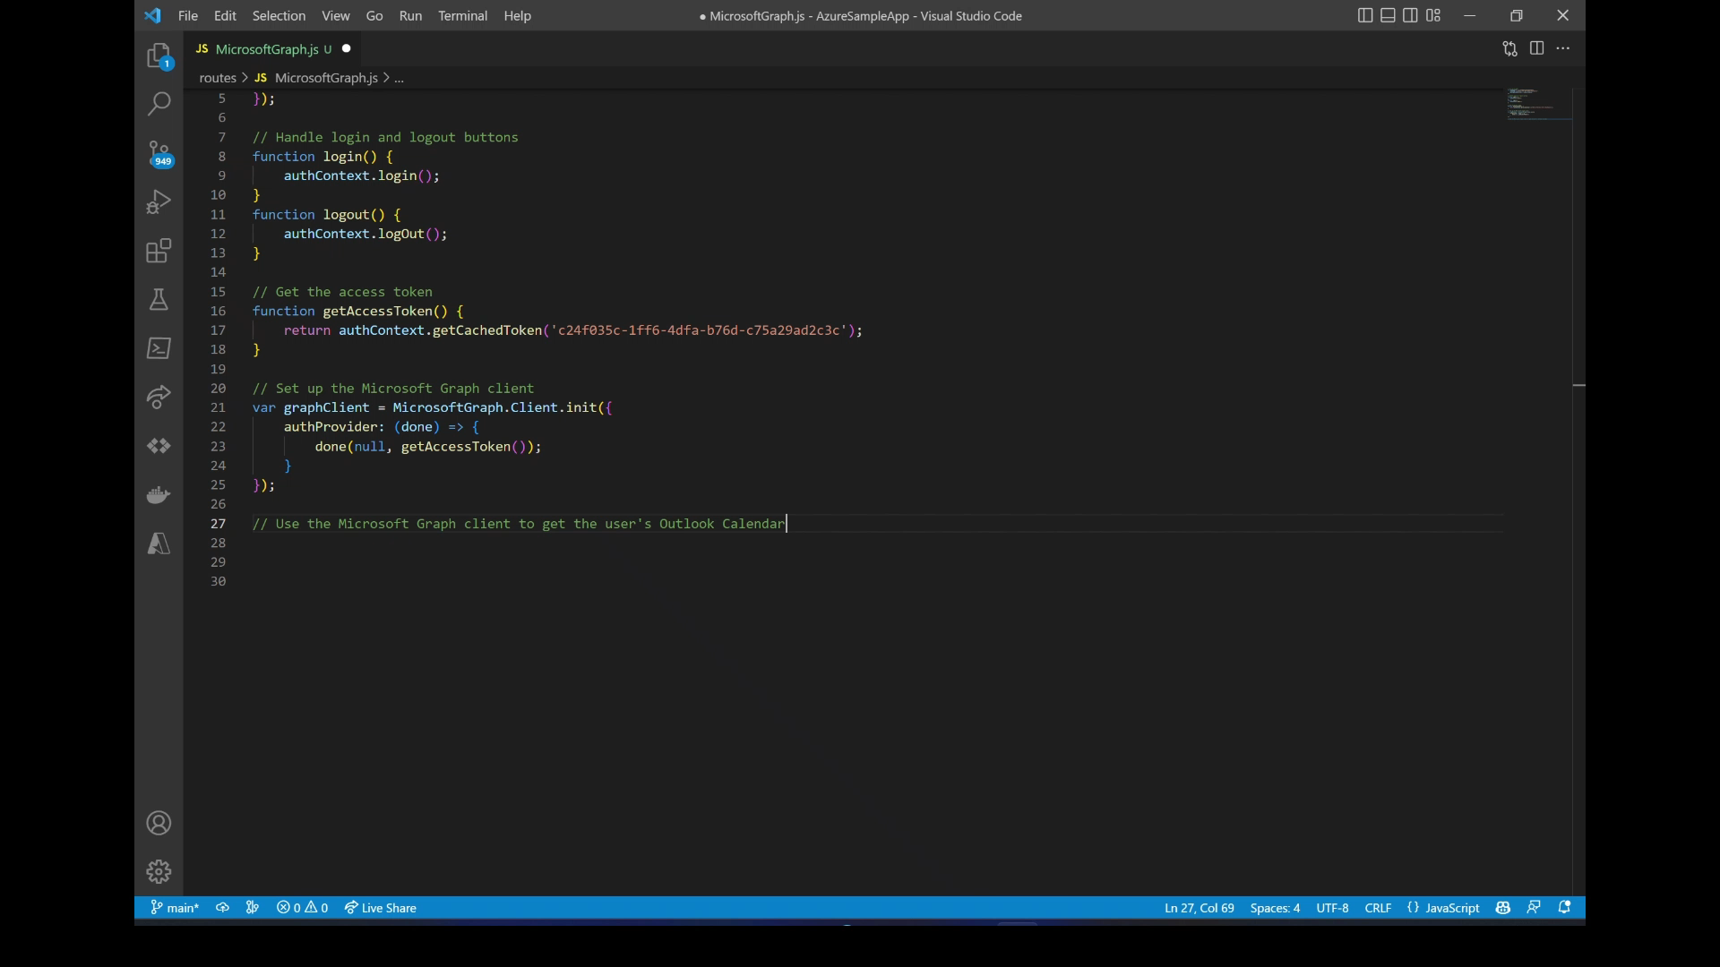
GitHub Copilot
“This is the single most mind-blowing application of machine learning I’ve ever seen.”
Mike Krieger, Co-founder, Instagram
Notes:
One of the most exciting new capabilities we’ve recently launched with GitHub is a new service we call GitHub Copilot.
Copilot was the first solution built using the new transformational large AI models developed by OpenAI.
Copilot provides an AI-pair programmer that works with all of the popular programming languages, and that dramatically accelerates developer productivity.
Developers using Github Copilot see a 55% productivity boost when working on real-world projects and tasks.
Let’s take a look at GitHub Copilot in action…

Slide 15
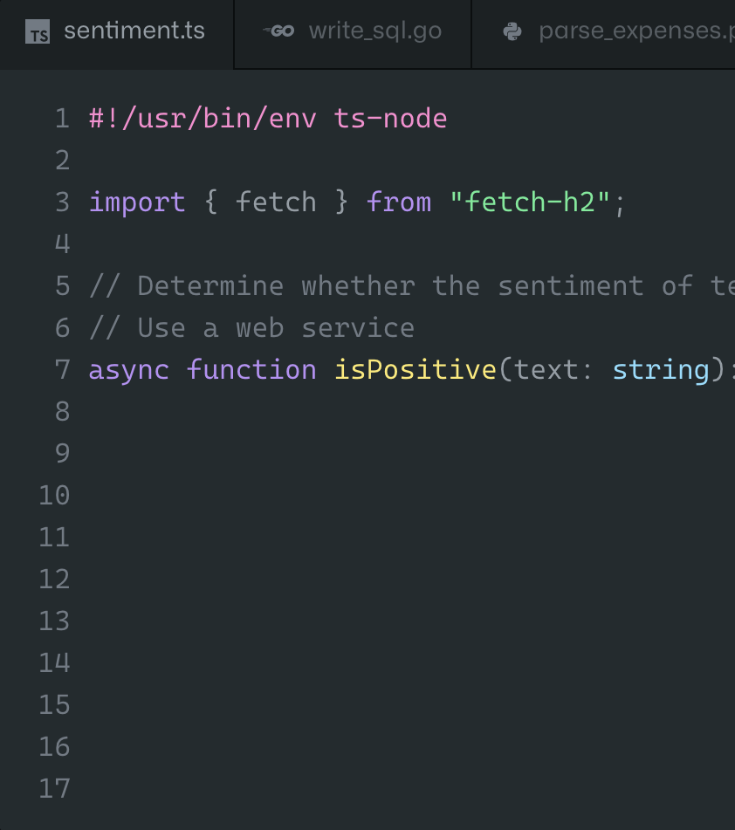

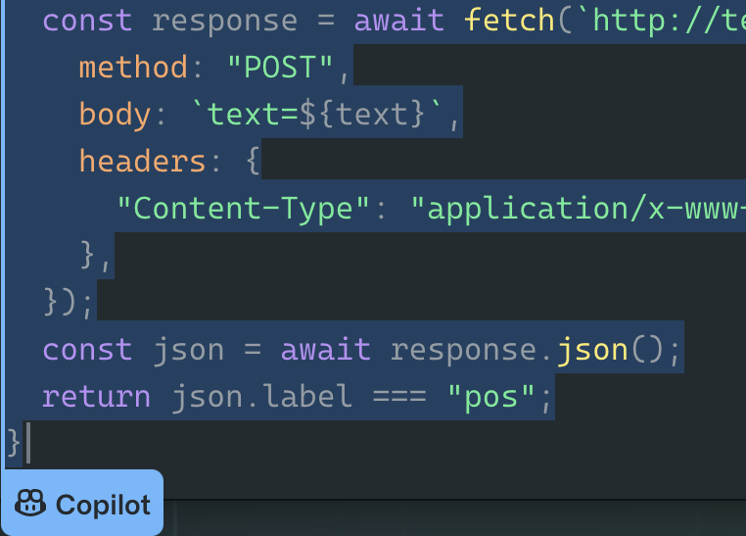
GitHub copilot detail
46%
of new code is now written by AI
55%
faster overall developer productivity
75%
developers feel more focused on satisfying work
Notes:
That video showed you a brief look at how Copilot transforms developers’ creation of code.
In fact, up to 45% of all lines of code written by developers using Copilot are now fully AI generated.
In measured tests conducted by 3rd parties, they’ve found that developers using Copilot are 55% more productive in completing tasks and applications.
But even more striking to me is what developers think about the Copilot experience – they love it. 75% of developers using Copilot report feeling that they can now focus on more satisfying work and enjoy their jobs more.
Debugging and looking up regular expressions is not satisfying. By having that work autogenerated, developers can instead focus on things that make them feel more satisfied, complete their work faster, and feel more productive. This is really transformational in terms of how development teams work.
Copilot for Business is generally available now for all developers to use today with all developer languages on all platforms and with all types of developer tools.

Slide 16
Microsoft Cloud
Industry clouds
c
b
a
Infrastructure
Comprehensive
Trusted
Security
Digital and app innovation
Business applications
Business applications
Data and AI
Modern work
Notes:
Now let’s talk about business applications.

Slide 17

Dynamics 365 Copilot
Dynamics 365 Copilot
Generate ideas and content faster
Perform and automate tasks faster
Get insights and next best actions
The world’s first AI copilot in both CRM and ERP
Copilot features powered by Azure OpenAI Service natively built-in to Dynamics 365
Build on Microsoft’s trusted and responsible AI foundation
Notes:
Nearly 9 out of every 10 workers say that automation and AI-powered tools would help them focus on more meaningful work.
That’s why we’ve introduced Dynamics 365 Copilot. Just as Github Copilot transforms how developers create code, Dynamics 365 Copilot will transform business processes across the organization.
Microsoft Dynamics 365 Copilot provides interactive, AI-powered assistance across business functions. With Dynamics 365 Copilot, we’re introducing the world’s first AI copilot natively built-in to both CRM and ERP applications.
And it’s built on the secure and trusted foundation of the Microsoft Cloud, with the same commitments to responsible AI we’ve talked about already.
Let’s zoom into one of those AI-powered experiences: Sales.

Slide 18
Microsoft Cloud
Industry clouds
c
b
a
Infrastructure
Infrastructure
Comprehensive
Trusted
Security
Digital and app innovation
Business applications
Data and AI
Modern work
Notes:
Let’s close with infrastructure – it’s quite literally the foundation for everything we’ve talked about so far today.
To deliver on its potential, AI requires more scale and processing power than ever. Compute requirements for AI are expected to grow by 10-50x as AI’s capabilities become even more sophisticated.
As a result, the best infrastructure for AI does not simply provide sheer power; it provides performance asynchronously and at scale. Microsoft has been architecting that infrastructure responsibly - with safeguards and security built-in - since 2017.

Slide 19

OpenAI relies on Azure AI Infrastructure
relies on Azure AI Infrastructure
Notes:
Azure’s AI optimized infrastructure is powering all the AI innovation you are seeing from Microsoft.
Microsoft Azure is also fundamental to our partnerships with AI innovators like OpenAI – who built and run ChatGPT on Azure, and trained the enormously advanced large AI models that are stunning the world right now.
And Azure's differentiated infrastructure will be the processing power behind even more apps and services to come.

Slide 20
AI Infrastructure
AI at any scale with AI optimized Azure Virtual Machines
Purpose-built AI infrastructure
Reliability at scale for large AI models
Proven AI supercomputing performance
Notes:
Azure AI Infrastructure is a portfolio of Virtual Machines and connected cloud infrastructure resources, optimized to support AI workloads in the cloud.
The purpose-built AI infrastructure is designed to optimally handle everything from complex deep learning workloads like large language models, to training and inference, making AI more accessible to organizations of all sizes.
Where performance of high-end training can often be sensitive, only Azure’s AI infrastructure gives speed and reliability at scale for these large AI models, processing a single job running synchronously across 1,000s of interconnected GPUs.
Whether its running Microsoft’s own AI workloads or building out a cloud-based AI supercomputer for the development of Open AI, Azure’s AI infrastructure demonstrates proven supercomputing performance across the industries most advanced AI initiatives.

Slide 21

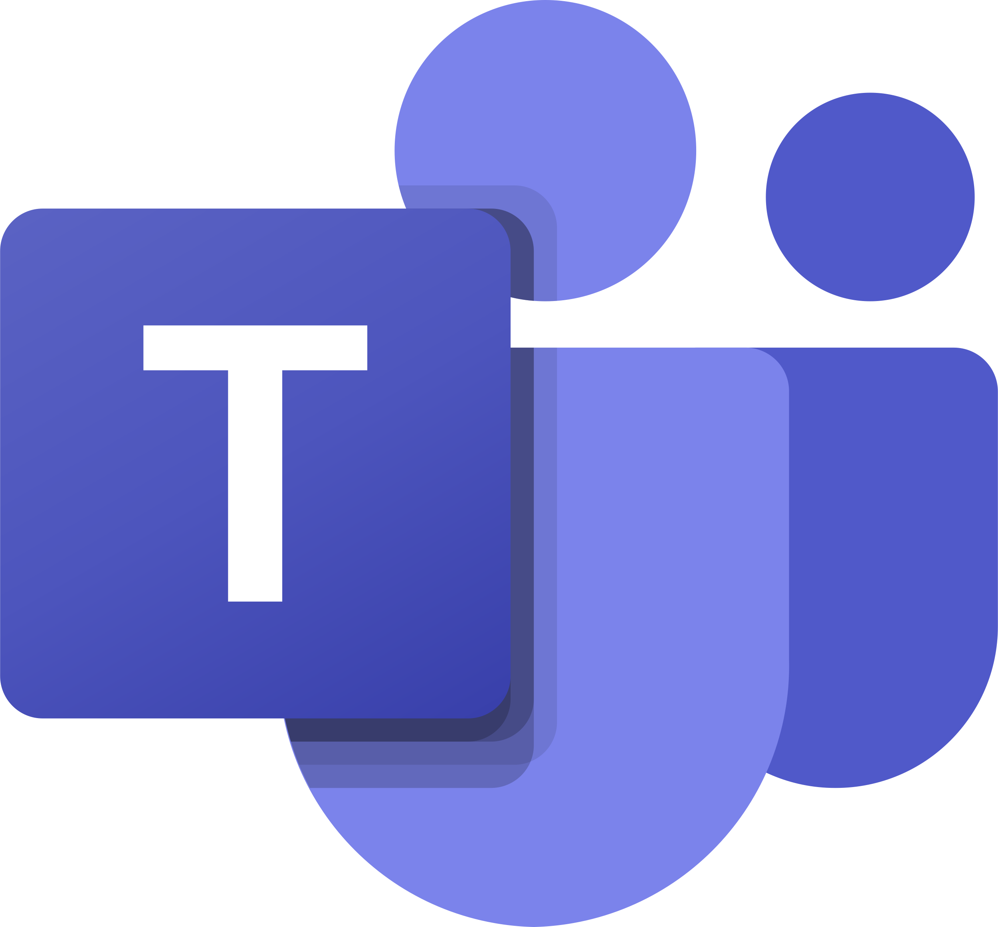

Microsoft runs on Azure AI Infrastructure
7.5 Trillion
Characters translated per month
54 Million
Meeting hours transcribed per month
100 Million
Monthly active users of AI text predictions
Notes:
The innovation you’ve seen in these demos today is driven by Azure AI.
Azure AI powers the transformational experiences at scale across the Microsoft Cloud. These statistics speak to just some of the monthly usage of AI that helps accelerate the productivity of every organization using the Microsoft Cloud today.

Slide 22

works alongside you in the apps you use every day
Microsoft 365 Copilot
Unleash creativity
Unlock productivity
Uplevel skills
Harness the power of AI so you never have to start from scratch
Let AI summarize actions for you, and optimize your time
Be better at what you’re good at and master what you’ve yet to learn
Notes:
We are excited to introduce Microsoft 365 Copilot – your copilot for work, bringing the power of next-generation AI to work. Just by using your words, you can put Copilot to work – gathering information in real time from across your data and apps to unleash creativity, unlock productivity, and uplevel skills.
Now, you can be more creative in Word, more analytical in Excel, more expressive in PowerPoint, more productive in Outlook and more collaborative in Teams.
Microsoft 365 Copilot isn’t just a better way of doing the same things. It’s an entirely new way of working.
Copilot combines the power of large language models with your data in the Microsoft Graph, and the Microsoft 365 apps you use every day to turn your words into the most powerful productivity tool on the planet.
Copilot is integrated into Microsoft 365 in two ways.
First, it works alongside you, embedded in the Microsoft 365 apps you use every day – Word, Excel, PowerPoint, Outlook, Teams and more.
Second, it is a new chat-based app that works across all your Microsoft 365 apps and data in real time – your calendar, emails, chats, documents, meetings and contacts.
Let’s talk about that a little bit more.

Slide 23
Microsoft 365 Copilot
Embedded across Microsoft 365 apps
Copilot in Word
Copilot in Excel
Copilot in PowerPoint
Copilot in Outlook
Copilot in Teams
Write, edit, summarize, and create
Analyze and explore your data
Turn ideas into stunning presentations
Clean up your inbox and messages
Run more effective meetings
And so much more
Notes:
In addition to the Business Chat capabilities we just saw, Microsoft 365 Copilot works alongside you in the apps you use every day to unleash creativity, unlock productivity, and uplevel skills.
Our products are so rich and powerful, but most people tap into less than 10% of what our apps are capable of.
What if the tools could learn how you work, rather than the other way around?
Copilot unlocks all the richness of these apps through natural language across Word, Excel, PowerPoint, Outlook, Teams, and more.

Slide 24



Microsoft 365 Copilot
Natural Language
Large Language Models
Your data
Microsoft 365 apps
Business Chat brings together data from documents, presentations, email, calendar, notes, and contacts – all using natural language
Notes:
Business Chat is an entirely new experience that works across ALL your emails, files, meetings, chats, documents, calendar, and more to turn ALL your data into knowledge.
It’s your knowledge navigator.
Bring together information from multiple sources to keep everyone on the team on the same page and moving forward together.
Spend less time focused on the tools, and more time focused on the most important work. You can ask Copilot to summarize what’s going on with a given customer, highlight project milestones or risks, or create new content using references from across your data.
Let’s take a look at Business Chat in action.

Slide 25
Microsoft Cloud
Industry clouds
c
b
a
Infrastructure
Comprehensive
Trusted
Security
Digital and app innovation
Security
Business applications
Data and AI
Modern work
Notes:
Let’s close with infrastructure – it’s quite literally the foundation for everything we’ve talked about so far today.
To deliver on its potential, AI requires more scale and processing power than ever. Compute requirements for AI are expected to grow by 10-50x as AI’s capabilities become even more sophisticated.
As a result, the best infrastructure for AI does not simply provide sheer power; it provides performance asynchronously and at scale. Microsoft has been architecting that infrastructure responsibly - with safeguards and security built-in - since 2017.

Slide 26
The odds are against today’s defenders
1,287
Password attacks per second
1h 12mins
Median time for an attacker to move laterally once a device is compromised
3.4M
Global shortage of skilled security workers
Notes:
Firstly, to set the stage and give some context, Security is a defining challenge of our times.
Just since September 0f 2021, the number of password attacks per second has risen from 579 to 1,287.
And the median time for an attacker to access your private data if you fall victim to a phishing email is only 1 hour and 12 minutes
Add to that a global shortage of 3.4 million skilled security professionals, and it’s no wonder that security incidents have become an everyday occurrence in organizations of every size, in every industry, and in every part of the world.
So how do we tip the scales in favor of defenders? How do we scale humans more effectively and utilize them more strategically? The answer is, we need a paradigm shift. Human ingenuity and expertise will always be a precious and irreplaceable component of defense, so we need technology that can augment these unique capabilities with the skill sets, processing speeds, and rapid learning of AI. Technology that can work alongside us, detect hidden patterns and behaviors, and inform their response at machine speed with the latest and most advanced security practices.
Sourcing on the 3.4M global talent shortage - 2022 (ISC)2 Cybersecurity Workforce Study released Thursday.

Slide 27
Always
Learning
We need a paradigm shift
Deploying
human ingenuity
where it matters
Augmenting humans
with machine scale
Notes:
So how do we tip the scales in favor of defenders?
How do we scale humans more effectively and utilize them more strategically?
The answer is, we need a paradigm shift.
Human ingenuity and expertise will always be a precious and irreplaceable component of defense, so we need tools that can augment these unique capabilities with the skill sets, processing speeds, and rapid learning of AI. Tools that can work alongside us, detect latent patterns and behaviors, and inform their response at machine speed with the latest and most advanced security practices.

Slide 28
Your data is your data
Microsoft Security Copilot
Your data is not used to train the foundation AI models
Your data is protected by the most comprehensive enterprise compliance and security controls
Notes:
The first and only generative AI security product to help defend organizations at machine speed and scale.
With Security Copilot, your data is always your data.
It stays within your boundaries, and it is not used to train the foundational AI models.
In fact, it is protected by the most comprehensive enterprise compliance and security controls.

Slide 29

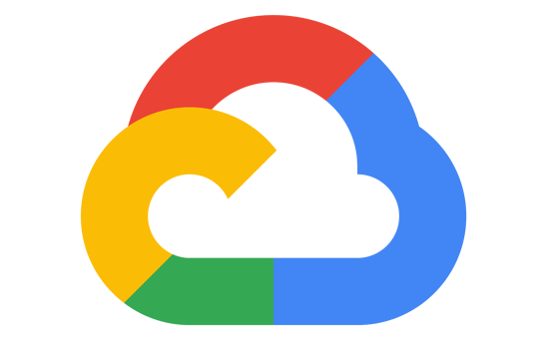




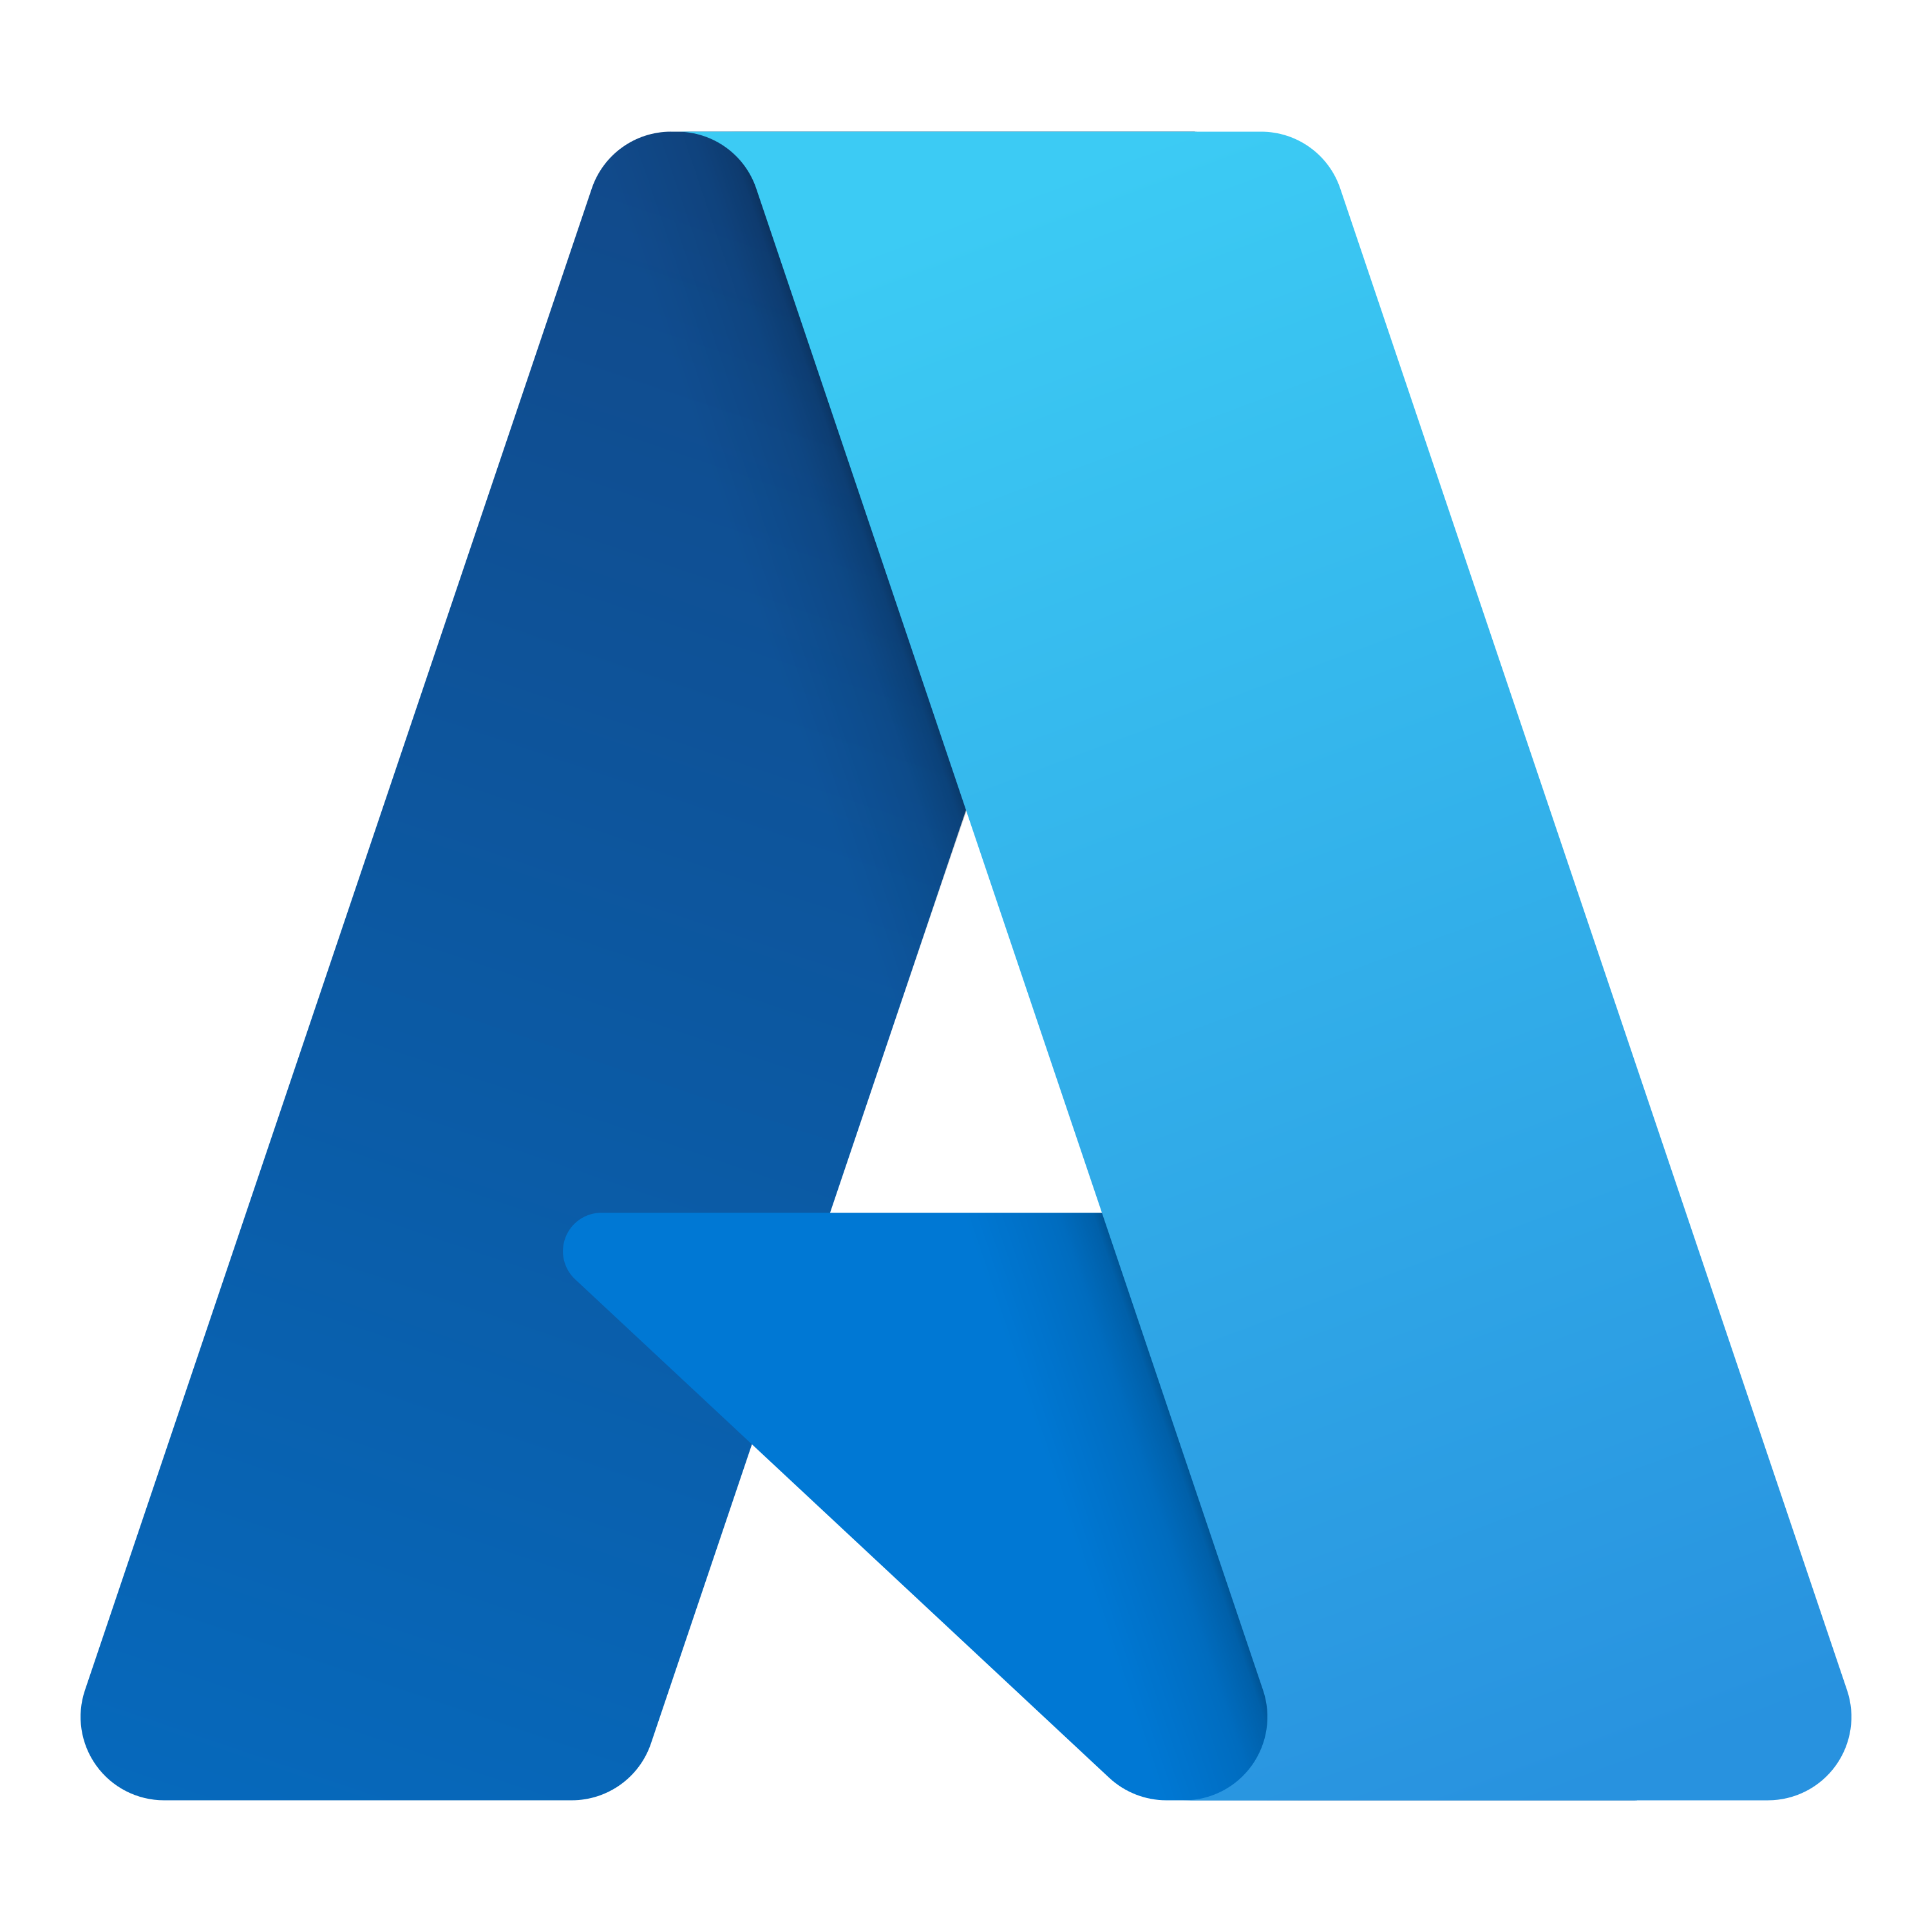




Microsoft Security Portfolio
Microsoft
Defender
Microsoft
Purview
Cloud
platforms
Device
OSs
Microsoft Security Copilot
Microsoft
Sentinel
Microsoft
Priva
Microsoft
Entra
Microsoft
Intune
Microsoft Security Experts
Notes:
And it all comes together with Security Copilot at the heart of the Microsoft Security product portfolio.

Slide 30
Microsoft Cloud
Industry clouds
c
b
a
Microsoft Cloud
Infrastructure
Comprehensive
Trusted
Security
Digital and app innovation
Radically accelerate your organization’s productivity with built-in AI
Business applications
Data and AI
Differentiate from the competition with intelligent apps using AI
Modern work
Notes:
Let’s go deeper now and talk about some of the work we are doing to radically accelerate productivity using AI built into the Microsoft cloud services.

Slide 31
Microsoft Cloud
Industry clouds
c
b
a
Microsoft Cloud
Infrastructure
Comprehensive
Trusted
Security
Digital and app innovation
Radically accelerate your organization’s productivity with built-in AI
Business applications
Data and AI
Differentiate from the competition with intelligent apps using AI
Modern work
Notes:
Let's focus on how you can build transformational experiences into your own apps and services using Azure AI.

Slide 32
In the age of AI, every app should be intelligent
Apps
Data
AI Models
Notes:
In the age of AI, intelligent app experiences become competitive differentiators. Increasingly, organizations are turning to cloud-native technologies and AI/ML to develop their mission-critical applications.
These modern technologies and models provide organizations with the security, agility and velocity required to scale and transform.
Leveraging cloud apps + data + AI services is how every organization can stand out from the competition with intelligent apps built with AI.

Slide 33




Azure AI
Azure Machine Learning
Cognitive Services
Azure AI Infrastructure
Azure OpenAI Service
Notes:
When we talk about Azure AI, it includes four core categories of AI capabilities, all informed by decades of Microsoft’s research and development in this space.
Azure Machine Learning, Cognitive Services, Azure AI Infrastructure, and our new Azure OpenAI Service – which became generally available in January.
With Azure's cloud application platform, you can run intelligent cloud-native apps with Azure Kubernetes Service or gain the productivity and rapid time to market benefits of platform-as-a-service with App Service.
Apps running on AKS or App Service can easily and natively embed Azure AI services.

Slide 34





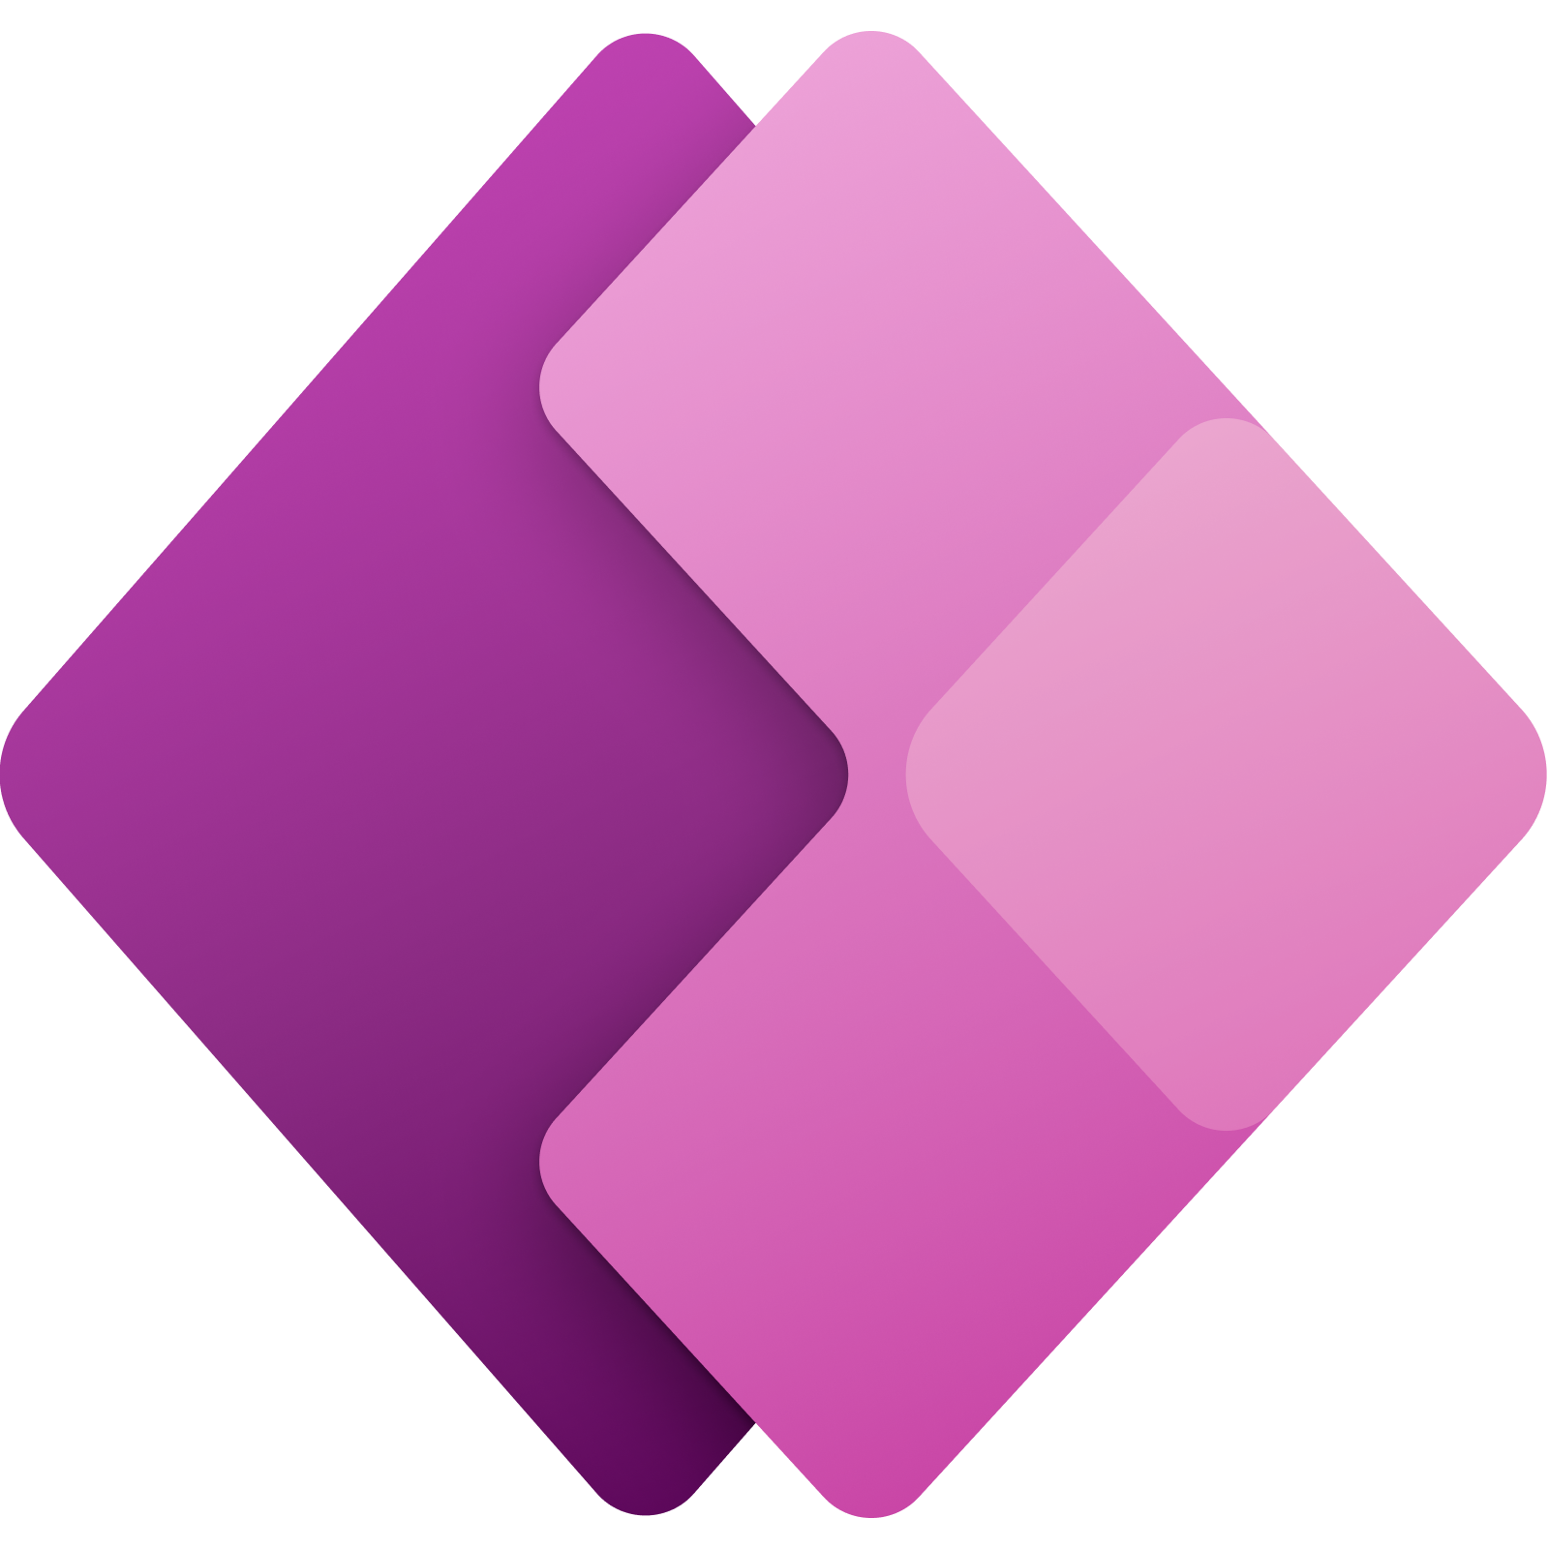










Azure AI Portfolio
Applications
Partner Solutions
Business Users
Application Platform
AI Builder
Power BI
Power Apps
Power Automate
Power Virtual Agents
Scenario-Based Services
Applied AI Services
Bot Service
Cognitive Search
Form Recognizer
Video Indexer
Metrics Advisor
Immersive Reader
Customizable AI Models
Cognitive Services
Developers & Data Scientists
Vision
Speech
Language
Decision
OpenAI Service
ML Platform
Azure Machine Learning
Notes:
Yes, Azure OpenAI is one new service in our portfolio of services and software

Slide 35
Microsoft Cloud
Runs on trust
Notes:
Now, as we mentioned earlier, trust is critically important when it comes to realizing the full potential of AI technology – and the Microsoft Cloud runs on trust.
I want to talk about two elements of trust here.
First, let’s talk a little more about responsible AI.

Slide 36
Responsible AI built into Azure AI
Fairness
Explainability
Counterfactuals
Assess fairness and mitigate fairness issues to build models for everyone.
Understand model predictions by generating feature importance values for your mode.
Observe feature perturbations and find the closest datapoints with different model predictions.
Causal analysis
Error analysis
Responsible AI scorecard
Estimate the effect of a feature on real-world outcomes.
Identify dataset cohorts with high error rates and visualize error distribution in your model.
Get a PDF summary of your Responsible AI insights to share with your technical and non-technical stakeholders to aid in compliance reviews.
Notes:
This is a core value for us at Microsoft.
We’re not just setting a standard for the industry, but we’re also providing the tooling and capabilities for you to build responsible AI solutions right from the start – and we’re using the same principles and tools to build our own AI experiences.
Our work on Privacy, and GDPR in particular, taught us the importance of engineered systems and tools. It’s not just good enough to have a standard. You really need the tools and the engineering systems to help make it easy for your teams to adopt it.
Built into our Azure AI services are templates, dashboards, reports and tools that you can use to debug AI models and understand AI decision-making and outcomes.
This gives you the AI engineering system you need to build responsible AI into all of your own apps and services, and make responsible AI part of the everyday way your data scientists and engineering teams work.

Slide 37
Microsoft Cloud
Your data is your data
Your data from any fine-tuning is not used to train the foundation AI models
Runs on trust
Your data is protected by the most comprehensive enterprise compliance and security controls
Notes:
Additionally, the key to unlocking the value of AI is data.
You’re going to be sharing a lot of data with AI, and the AI may learn and be trained on the data you provide.
This means you absolutely must trust your cloud provider.
Let me expand on this a little more, and what this means, in the context of our Azure AI platform and the commitments we make to you.

Slide 38
Microsoft Cloud
Industry clouds
c
b
a
Infrastructure
Comprehensive
Trusted
Security
Digital and app innovation
Microsoft Cloud
Radically accelerate your organization’s productivity with built-in AI
Business applications
Data and AI
Differentiate from the competition with intelligent apps using AI
Modern work
Notes:
I hope this overview has left you feeling inspired by the possibility of AI, as well as safe in the knowledge that Microsoft is providing a trusted and secure platform you can leverage.
Today we’ve talked about two things.
First, we showed you how we’re building AI into the products and services you’re already using each day.
And second, we talked about how you can build your own intelligent apps and experiences with those same Azure AI capabilities.
Let’s look at how organizations can realize this potential today, even beyond the examples we’ve already seen.

Slide 39
How do I get started?
Get your data estate AI-ready with Azure
Build intelligent app experiences with Azure AI
Increase developer productivity with GitHub
Increase business productivity with Dynamics
Learn how migrating your data to Azure can give you the foundation for better AI experiences
Learn how to build AI-powered applications for your organization on Azure
Learn how GitHub Copilot can drive 55% greater productivity with developers
Learn Microsoft Dynamics 365 Copilot provides interactive, AI-powered assistance across business functions.
Conduct a data estate assessment
Book an AI executive briefing session
Try GitHub Copilot today
Try Dynamics today
Microsoft for Startups Founders Hub
Build your startup business on Azure. Developer at your own pace with up to $150,000 in Azure credits, redeemable over time. The support you need, just when you need it. Apply now!
Notes:
So hopefully by this point you’re asking yourself “Great! How do I get started?”
Let’s walk through a few suggestions as potential starting points.
Getting AI-ready means you’ve invested time to evaluate your data estate and are making the necessary moves to migrate your data to Azure. You can set up a briefing on the Microsoft Intelligent Data Platform and conduct a data estate assessment.
With your data estate well managed, you’ll want to explore intelligent app experiences with Azure AI. An AI workshop to identify use cases can help you unlock competitive differentiation through your data.
Now, we know developing applications can be time consuming, but with GitHub Copilot you can significantly increase developer productivity. Customers using Github Copilot are reporting that their developers are 55% faster – and who doesn’t need more development resources today?
Lastly, Viva Sales is an impactful tool to increase seller productivity, harnessing the power of generative AI to automatically create rich, customer relevant content right inside the Microsoft 365 apps your team already uses every day.
This is just the beginning of what the age of AI holds in store for us as we continue to pursue our vision to empower every person and every organization on the planet to achieve more.
We’re so excited, and hope you are too!

